Slide 1

Ethics in Information Technology, Second Edition
Chapter 4
Privacy

Slide 2
Objectives
Apa hak privasi, dan apa dasar untuk melindungi privasi pribadi di bawah hukum?
Apa saja hukum yang mengesahkan pengawasan elektronik oleh pemerintah, dan apa masalah etika yang terkait?
Apa dua bentuk mendasar dari enkripsi data, dan bagaimana masing-masing berfungsi?
Ethics in Information Technology, Second Edition

Slide 3
Objectives (continued)
Apa itu pencurian identitas, dan teknik apa yang digunakan pencuri identitas?
Apa berbagai strategi untuk profil konsumen dan masalah etika terkait?
Apa yang harus dilakukan organisasi untuk memperlakukan data konsumen secara bertanggung jawab?
Ethics in Information Technology, Second Edition

Slide 4
Objectives (continued)
Mengapa dan bagaimana pengusaha semakin menggunakan pemantauan di tempat kerja?
Apa itu spamming, dan masalah etika apa yang dikaitkan dengan penggunaannya?
Apa kemampuan teknologi pengawasan canggih, dan masalah etika apa yang mereka angkat?
Ethics in Information Technology, Second Edition

Slide 5
Apa arti privasi bagi Anda?

Slide 6

What is privacy?
“Being alone.”
Al-Bara Al-Ohli (age 4)
Ethics in Information Technology, Second Edition

Slide 7
Westin “Privacy and Freedom” 1967
"Privasi adalah klaim individu, kelompok, atau lembaga untuk menentukan sendiri kapan, bagaimana, dan sejauh mana informasi tentang mereka dikomunikasikan kepada orang lain"
Privasi tidak mutlak
Ethics in Information Technology, Second Edition

Slide 8
Privacy as process
"Setiap individu terus terlibat dalam proses penyesuaian pribadi di mana ia menyeimbangkan keinginan untuk privasi dengan keinginan untuk pengungkapan dan komunikasi ...."
- Alan Westin, 1967
Ethics in Information Technology, Second Edition
Notes:
Westin’s definition envisions an individual actively involved in a decision making process.
It assumes a certain level of individual awareness of the consequences of both disclosing and not disclosing personal information, and the ability to effectively control whether information is disclosed.

Slide 9
Westin’s four states of privacy
Kesendirian
individu terpisah dari kelompok dan dibebaskan dari pengamatan orang lain
Keintiman
individu adalah bagian dari unit kecil
Anonimitas
individu di depan umum tetapi masih mencari dan menemukan kebebasan dari identifikasi dan pengawasan
Cadangan
penciptaan penghalang psikologis terhadap intrusi yang tidak diinginkan - menahan komunikasi
Ethics in Information Technology, Second Edition

Slide 10
Privacy Protection and the Law
Sistem mengumpulkan dan menyimpan data utama dari setiap interaksi dengan pelanggan
Banyak yang keberatan dengan kebijakan pengumpulan data pemerintah dan bisnis
Privasi adalah a
Perhatian utama pengguna Internet
Alasan utama mengapa bukan pengguna masih menghindari Internet
Batas wajar harus ditetapkan
Perspektif historis tentang hak privasi
Amandemen Keempat - harapan privasi yang masuk akal
Ethics in Information Technology, Second Edition

Slide 11
Hak Privasi
Definition
  “Hak untuk dibiarkan sendiri — hak yang paling komprehensif, dan hak yang paling dihargai oleh orang bebas”
  “Hak individu untuk mengontrol pengumpulan dan penggunaan informasi tentang diri mereka sendiri”
Ethics in Information Technology, Second Edition

Slide 12
Recent History of Privacy Protection
Legislative acts passed over the past 40 years
  Most address invasion of privacy by the government
    Not corporations
  No single, overarching national data privacy policy
    Communications Act of 1934
    Freedom of Information Act (FOIA)
    Fair Credit Reporting Act of 1970
    Privacy Act of 1974
    Children’s Online Protection Act (COPA)
    European Community Directive 95/46/EC of 1998
    Gramm-Leach-Bliley Act
Ethics in Information Technology, Second Edition

Slide 13
Chief privacy officers
Companies are increasingly appointing CPOs to have a central point of contact for privacy concerns
Role of CPO varies in each company
  Draft privacy policy
  Respond to customer concerns
  Educate employees about company privacy policy
  Review new products and services for compliance with privacy policy
  Develop new initiatives to keep company out front on privacy issue
  Monitor pending privacy legislation
Ethics in Information Technology, Second Edition

Slide 14





Other initiatives (Seal programs)
TRUSTe – http://www.truste.org
BBBOnline – http://www.bbbonline.org
CPA WebTrust – http://www.cpawebtrust.org/
Japanese Privacy Mark http://privacymark.org/
  Independent, nonprofit initiatives
  Favor an industry-regulated approach to data privacy
Ethics in Information Technology, Second Edition

Slide 15
Tinjauan Hukum: Undang-Undang Privasi
Secure Flight airline safety program
  Membandingkan nama dan informasi 1,4 juta penumpang harian AS dengan data tentang teroris yang diketahui atau diduga.
  Pelanggaran Undang-Undang Privasi
Ethics in Information Technology, Second Edition

Slide 16
Key Privacy and Anonymity Issues
Pengawasan elektronik pemerintah
Enkripsi data
Pencurian identitas
Profil pelanggan
Perlu memperlakukan data pelanggan secara bertanggung jawab
Pemantauan tempat kerja
Spamming
Teknik pengawasan tingkat lanjut
Ethics in Information Technology, Second Edition

Slide 17
Governmental Electronic Surveillance
Federal Wiretap Act
  Outlines processes to obtain court authorization for surveillance of all kinds of electronic communications
  Judge must issue a court order based on probable cause
    Almost never deny government requests
  “Roving tap” authority
    Does not name specific telephone lines or e-mail accounts
    All accounts are tied to a specific person
Ethics in Information Technology, Second Edition

Slide 18
Governmental Electronic Surveillance (continued)
Electronic Communications Privacy Act of 1986 (ECPA)
  Sets standards for access to stored e-mail and other electronic communications and records
  Extends Title III’s prohibitions against the unauthorized interception, disclosure, or use of a person’s oral or electronic communications
  Prosecutor does not have to justify requests
  Judges are required to approve every request
Ethics in Information Technology, Second Edition

Slide 19
Governmental Electronic Surveillance (continued)
Electronic Communications Privacy Act of 1986 (ECPA)
  Highly controversial
    Especially collection of computer data sent over the Internet
  Failed to address emerging technologies
Ethics in Information Technology, Second Edition

Slide 20
Governmental Electronic Surveillance (continued)
Undang-Undang Pengawasan Intelijen Asing 1978 (FISA)
Mengizinkan penyadapan orang asing dan warga negara di Amerika Serikat
Berdasarkan temuan kemungkinan penyebab bahwa target adalah
Anggota kelompok teroris asing
Agen kekuatan asing
Perintah Eksekutif 12333
Otoritas hukum untuk pengawasan elektronik di luar Amerika Serikat
Ethics in Information Technology, Second Edition

Slide 21
Governmental Electronic Surveillance (continued)
Bantuan Komunikasi untuk Undang-Undang Penegakan Hukum (CALEA)
Memerlukan industri telekomunikasi untuk membuat alat menjadi produknya sehingga penyelidik federal dapat menguping pembicaraan
Setelah mendapat persetujuan pengadilan
Berisi ketentuan yang mencakup komunikasi data berbasis radio
Termasuk teknologi voice over Internet (VoIP)
Ethics in Information Technology, Second Edition

Slide 22
Governmental Electronic Surveillance (continued)
USA Patriot Act of 2001
  Gives sweeping new powers to
    Domestic law enforcement
    International intelligence agencies
  Contains several “sunset” provisions
Ethics in Information Technology, Second Edition

Slide 23
Data Encryption
Kriptografi
Ilmu penyandian pesan
Hanya pengirim dan penerima yang dituju yang dapat memahami pesan
Alat utama untuk memastikan kerahasiaan, integritas, keaslian pesan elektronik, dan transaksi bisnis online
Enkripsi
Proses mengubah pesan elektronik menjadi bentuk yang hanya dimengerti oleh penerima yang dituju
Ethics in Information Technology, Second Edition

Slide 24
Data Encryption (continued)
Encryption key
  Variable value applied using an algorithm to encrypt or decrypt text
Public key encryption system uses two keys
  Message receiver’s public key - readily available
  Message receiver’s private key - kept secret
RSA - a public key encryption algorithm
Private key encryption system
  Single key to encode and decode messages
Ethics in Information Technology, Second Edition

Slide 25
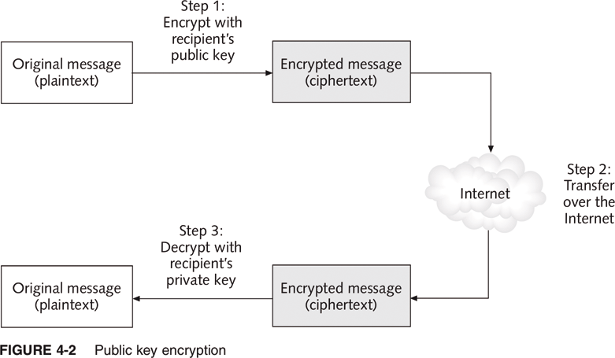
Public Key Encryption
Ethics in Information Technology, Second Edition

Slide 26
Data Encryption (continued)
Most people agree encryption eventually must be built into
  Networks
  File servers
  Tape backup systems
Seagate Technology hard drive
  Automatically encrypts all data
U.S. Arms Export Control Act controls the export of encryption technology, hardware, and software
Ethics in Information Technology, Second Edition

Slide 27
Identity Theft
Theft of key pieces of personal information to gain access to a person’s financial accounts
Information includes:
  Name
  Address
  Date of birth
  Social Security number
  Passport number
  Driver’s license number
  Mother’s maiden name
Ethics in Information Technology, Second Edition

Slide 28
Identity Theft (continued)
Bentuk penipuan yang tumbuh paling cepat di Amerika Serikat
Kurangnya inisiatif dalam memberi tahu orang-orang yang datanya dicuriPhishing
  Attempt to steal personal identity data
  By tricking users into entering information on a counterfeit Web site
  Spear-phishing - a variation in which employees are sent phony e-mails that look like they came from high-level executives within their organization
Ethics in Information Technology, Second Edition

Slide 29
Identity Theft (continued)
Spyware
  Keystroke-logging software
  Enables the capture of:
    Account usernames
    Passwords
    Credit card numbers
    Other sensitive information
  Operates even if an infected computer is not connected to the Internet
Identity Theft and Assumption Deterrence Act of 1998 was passed to fight fraud
Ethics in Information Technology, Second Edition

Slide 30
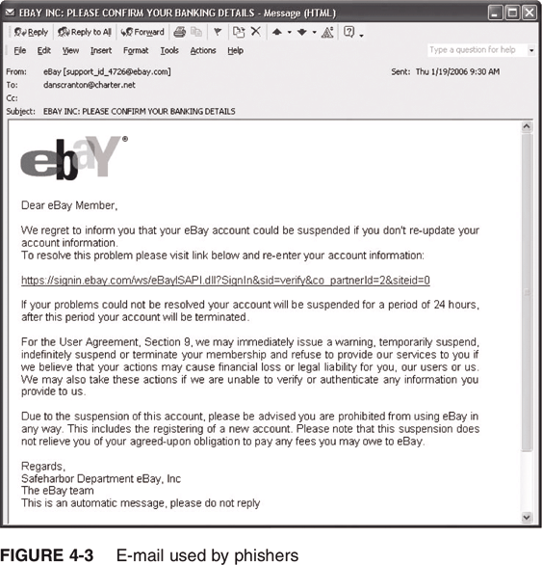
E-mail Used by Phishers
Ethics in Information Technology, Second Edition

Slide 31
Consumer Profiling
Companies openly collect personal information about Internet users
Cookies
  Text files that a Web site puts on a user’s hard drive so that it can remember the information later
Tracking software
Similar methods are used outside the Web environment
Databases contain a huge amount of consumer behavioral data
Ethics in Information Technology, Second Edition

Slide 32
Consumer Profiling (continued)
Affiliated Web sites
  Group of Web sites served by a single advertising network
Customized service for each consumer
Types of data collected while surfing the Web
  GET data
  POST data
  Click-stream data
Ethics in Information Technology, Second Edition

Slide 33
Consumer Profiling (continued)
Four ways to limit or even stop the deposit of cookies on hard drives
  Set the browser to limit or stop cookies
  Manually delete them from the hard drive
  Download and install a cookie-management program
  Use anonymous browsing programs that don’t accept cookies
Ethics in Information Technology, Second Edition

Slide 34
Consumer Profiling (continued)
Personalization software is used by marketers to optimize the number, frequency, and mixture of their ad placements
  Rules-based
  Collaborative filtering
  Demographic filtering
  Contextual commerce
Platform for Privacy Preferences (P3P)
  Shields users from sites that don’t provide the level of privacy protection desired
Ethics in Information Technology, Second Edition

Slide 35
Treating Consumer Data Responsibly
Strong measures are required to avoid customer relationship problems
Code of Fair Information Practices
1980 OECD privacy guidelines
Chief privacy officer (CPO)
  Executive to oversee data privacy policies and initiatives
Ethics in Information Technology, Second Edition

Slide 36
Workplace Monitoring
Employers monitor workers
  Ensures that corporate IT usage policy is followed
Fourth Amendment cannot be used to limit how a private employer treats its employees
  Public-sector employees have far greater privacy rights than in the private industry
Privacy advocates want federal legislation
  To keeps employers from infringing upon privacy rights of employees
Ethics in Information Technology, Second Edition

Slide 37
Spamming
Transmission of the same e-mail message to a large number of people
Extremely inexpensive method of marketing
Used by many legitimate organizations
Can contain unwanted and objectionable materials
Ethics in Information Technology, Second Edition

Slide 38
Spamming (continued)
Controlling the Assault of Non-Solicited Pornography and Marketing (CANSPAM)
  Says it is legal to spam but
    Spammers cannot disguise their identity
    There must be a label in the message specifying that the e-mail is an ad or solicitation
    They must include a way for recipients to indicate they do not want future mass mailings
Ethics in Information Technology, Second Edition

Slide 39
Advanced Surveillance Technology
Camera surveillance
  U.S. cities plan to expand surveillance systems
  “Smart surveillance system”
Facial recognition software
  Identifies criminal suspects and other undesirable characters
  Yields mixed results
Global Positioning System (GPS) chips
  Placed in many devices
  Precisely locate users
Ethics in Information Technology, Second Edition

Slide 40
Summary
The legal concept of the right to privacy has four aspects
A number of laws have been enacted over the past 40 years that affect a person’s privacy
Laws authorize electronic surveillance by the government
Data encryption
  Public key encryption system
  Private key encryption system
Identity theft
Ethics in Information Technology, Second Edition

Slide 41
Summary (continued)
Consumer behavior data is collected both online and offline
Code of Fair Information Practices and 1980 OECD privacy guidelines
Employers record and review employee communications and activities on the job
Advances in information technology
  Surveillance cameras
  Facial recognition software
  GPS systems
Ethics in Information Technology, Second Edition

